Slide 1
one dimensional motion (1-d) and kinematics

Slide 2
What is kinematics?
Kinematics in One Dimension. Kinematics analyzes the positions and motions of objects as a function of time, without regard to the causes of motion. It involves the relationships between the quantities displacement (d), velocity (v), acceleration (a), and time (t). The first three of these quantities are vectors

Slide 3
Kinematics vocabulary:
Scalar
Quantity with magnitude (size); no direction
Vector
Quantity with magnitude (size); with direction
Position
(vector quantity) Separation between an object and a reference point
Displacement
(vector quantity) The change in position; with direction (delta x=x2-x1)
Distance
(scalar quantity) The measured space (separation) between two objects
Independant Variable
The variable use to test

Slide 4
Dependant Variable
The variable that changes based on tests
Delta
The change in...
Speed
(scalar quantity) How fast; no direction
Velocity
(vector quantity) How fast; with direction
Acceleration
Change in velocity;
Slope
(velocity) rise/run
Constant Speed
Speed not changed; can change direction

Slide 5
Constant Velocity
Speed not changed; no change in direction
Instantaneous Velocity
The velocity at any given moment
Average Velocity
total distance/total time
Constant Acceleration
Every second, velocity increases by 20 m/s (vf=vi+at)
Instantaneous Acceleration
The acceleration at any given moment
Average Acceleration
delta v/delta t

Slide 6
Scalars and vectors
Scalars - Are quantities that are fully described by a magnitude (or numerical value)alone.
Vectors – Are quantities that are fully described by both a magnitude and a direction.

Slide 7
DISTANCE AND DISPLACEMENT
DISTANCE - Is a scalar quantity that refers to “how much ground an object has covered”during its motion.
DISPLACEMENT – Is a vector quantity that refers to “how far out of place an object is”;it is the objects overall change in position.

Slide 8

What is speed?
Speed is a scalar quantity that refers to "how fast an object is moving." Speed can be thought of as the rate at which an object covers distance. A fast-moving object has a high speed and covers a relatively large distance in a short amount of time. Contrast this to a slow-moving object that has a low speed; it covers a relatively small amount of distance in the same amount of time. An object with no movement at all has a zero speed.

Slide 9

FORMULA OF SPEED
The average speed during the course of a motion is often computed using the following formula

Slide 10
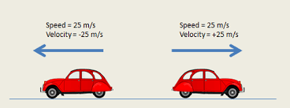
What is velocity?
Velocity is a vector quantity that refers to "the rate at which an object changes its position." Imagine a person moving rapidly - one step forward and one step back - always returning to the original starting position. While this might result in a frenzy of activity, it would result in a zero velocity. Because the person always returns to the original position, the motion would never result in a change in position. Since velocity is defined as the rate at which the position changes, this motion results in zero velocity. If a person in motion wishes to maximize their velocity, then that person must make every effort to maximize the amount that they are displaced from their original position. Every step must go into moving that person further from where he or she started. For certain, the person should never change directions and begin to return to the starting position.

Slide 11

Formula of velocity
In contrast, the average velocity is often computed using this formula.

Slide 12
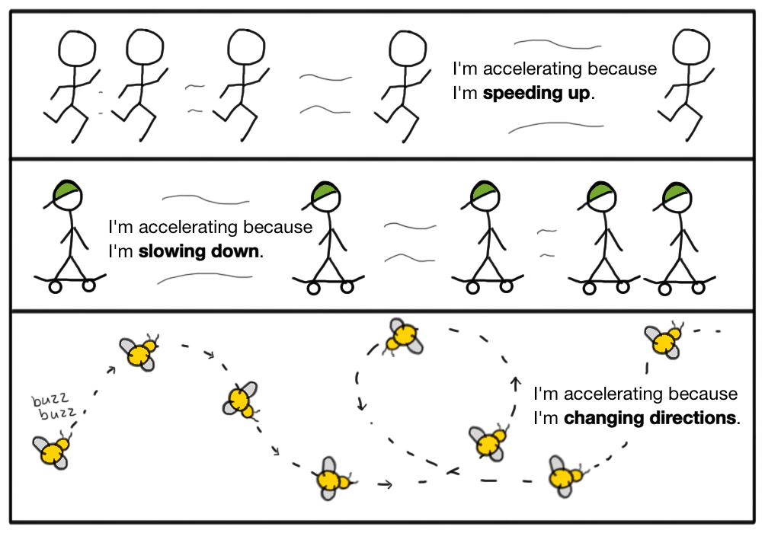
What is acceleration
Acceleration is a vector quantity that is defined as the rate at which an object changes its velocity. An object is accelerating if it is changing its velocity.

Slide 13
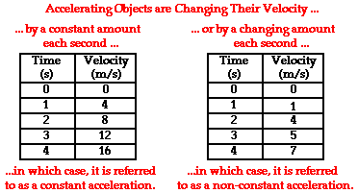
Sports announcers will occasionally say that a person is accelerating if he/she is moving fast. Yet acceleration has nothing to do with going fast. A person can be moving very fast and still not be accelerating. Acceleration has to do with changing how fast an object is moving. If an object is not changing its velocity, then the object is not accelerating. The data at the right are representative of a northward-moving accelerating object. The velocity is changing over the course of time. In fact, the velocity is changing by a constant amount - 10 m/s - in each second of time. Anytime an object's velocity is changing, the object is said to be accelerating; it has an acceleration.

Slide 14


Calculating the Average Acceleration
The average acceleration (a) of any object over a given interval of time (t) can be calculated using the equation
This equation can be used to calculate the acceleration of the object whose motion is depicted by the velocity-time data table above. The velocity-time data in the table shows that the object has an acceleration of 10 m/s/s. The calculation is shown below.

Slide 15
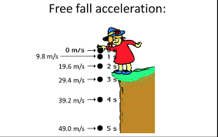
What is free fall
a free-falling object is an object that is falling under the sole influence of gravity. That is to say that any object that is moving and being acted upon only be the force of gravity is said to be "in a state of free fall." Such an object will experience a downward acceleration of 9.8 m/s/s. Whether the object is falling downward or rising upward towards its peak, if it is under the sole influence of gravity, then its acceleration value is 9.8 m/s/s.

Slide 16
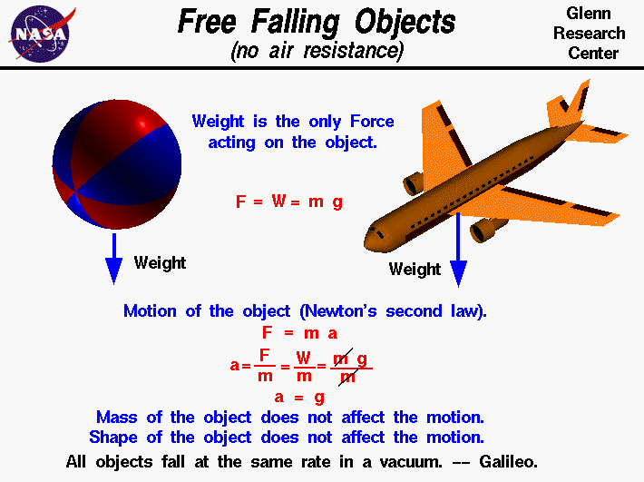
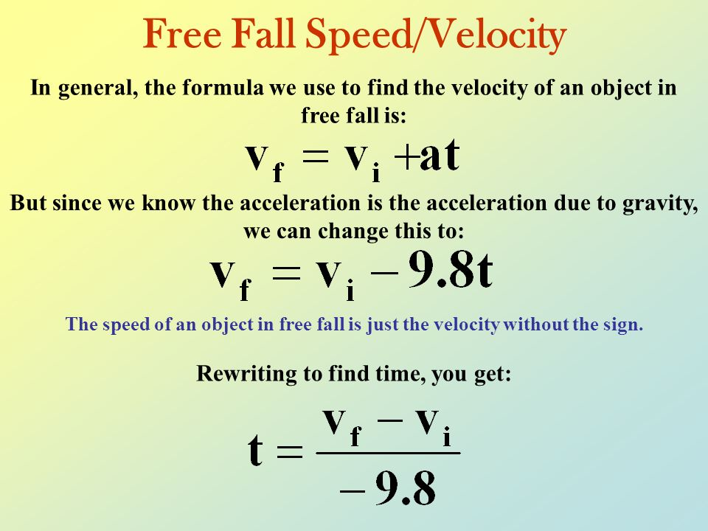
FORMULA OF FREE FALL
M

Slide 17
THANK YOU FOR WATCHING!
SUBMITTED BY: LAURENCE DUQUE
KENNETH GOTOC

